Slide 1
BITS F463 Cryptography
Term Project

Slide 2
TEAM MEMBERS
Giridhar Bajpai 2017B4A71451H
Akash Singh Chauhan 2017B4AA1484H
Pavan Kumar Uriti 2016A7PS0073H
Birju Vishnu Vardhan Raju 2016AAPS0202H
Sai Punith Bonagiri 2016A7PS0059H

Slide 3
BLOCKCHAIN
Blockchain is defined as a shared, immutable record of peer-to-peer transactions built from linked transaction blocks and stored in a digital ledger.
Blockchain is also similar to a database which stores information, however the main difference is that the data is located in a network of personal computers called nodes where there is no central entity such as a government or bank controlling the data.
Instead, all data is shared publicly although the contents of each data is only accessible to those with permission
Information is stored in distributed network compared to a centralized and decentralized network.

Slide 4
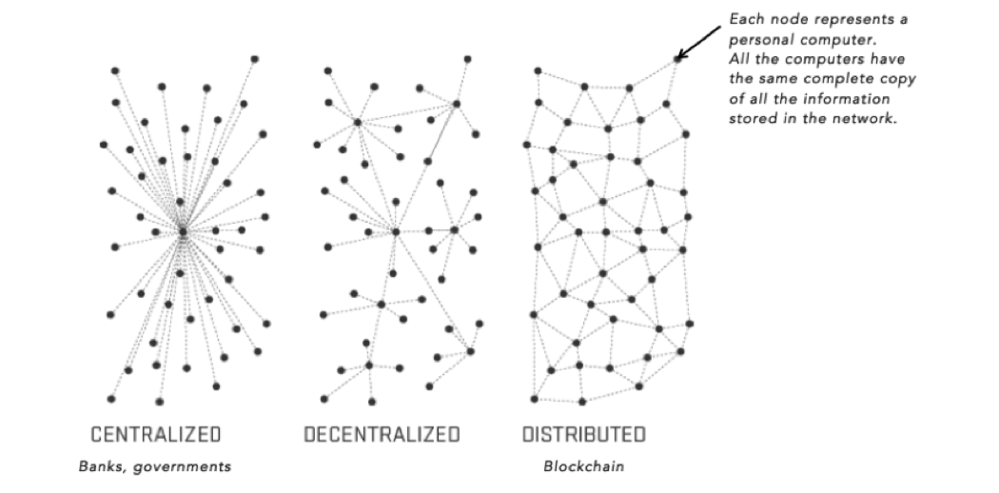

Slide 5
APPLICATIONS OF BLOCKCHAIN
Health Records
e-Notary
Collecting Taxes
Agriculture
Insurance Claims
Degrees and Certificates

Slide 6
BLOCKCHAIN IN HEALTHCARE
The current healthcare infrastructure has often been called inadequate to handle information exchange and requires certain tweaks.
One of the biggest things that make the use of blockchain revolutionary in healthcare is the lack of a central administrator.
If the contents of the database are stored in the physical memory of a particular system, anyone who has access to that system could corrupt the data within.
Since healthcare deals with confidential patient information and requires quick access to information, blockchain is useful in information security.

Slide 7
WHY?
No need for a central administrator.
All the users are in control of all their information and transactions.
Can streamline medical records and enable their sharing in a secure way.
Offers access security, scalability, and data privacy.

Slide 8
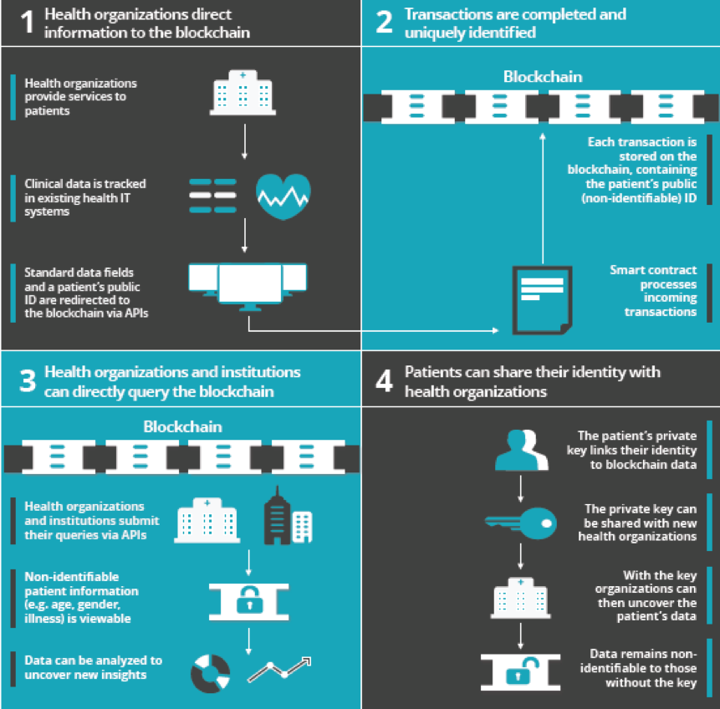

Slide 9
APPLICATIONS OF BLOCKCHAIN IN HEALTHCARE
Single, longitudinal patient records.
Master patient indices.
Claims adjudication.
Supply chain management.
Interoperability.

Slide 10
PLAN OF WORK
Suppose there is a multi-speciality hospital where politicians, big businessmen and many celebrities go for treatment and health check-ups.
The patient records maintained by the hospital are always under serious threat by outside attackers.
Currently the patient records are stored in physical memory of a system, and any attacker who has access to the system is a serious threat to the confidentiality, integrity and availability of the data.
So, in this case blockchain comes to our rescue.

Slide 11
PLAN OF WORK
These patient records having highly sensitive information are prone to threats both externally and internally.
If information is stored in a blockchain system, it can be secured from both type of threats.
In a blockchain system, every computer in each of the medical and administration departments will have the complete patient record.
If any attacker tries to add any information in the hospital system, he will get caught because in a blockchain system, if any information is to be added, it will have to be first verified by all computers in the system and then it will be added.

Slide 12
PLAN OF WORK
If the attacker tries to modify information, the hash (address) of all the subsequent data will change and so he cannot modify information directly.
More the information is decentralized, more secure it is because if any attacker wants to add data to the records, he will have to have the verification of more than half of the systems.

